Slide 1

Project Quack
Presented by
The Bestagons
Notes:
Miles

Slide 2
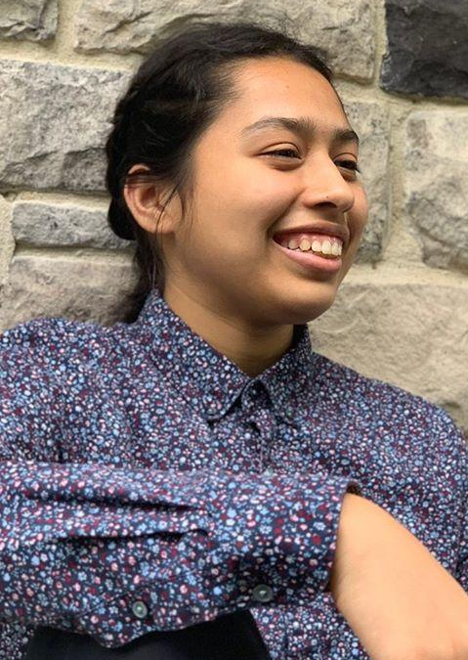
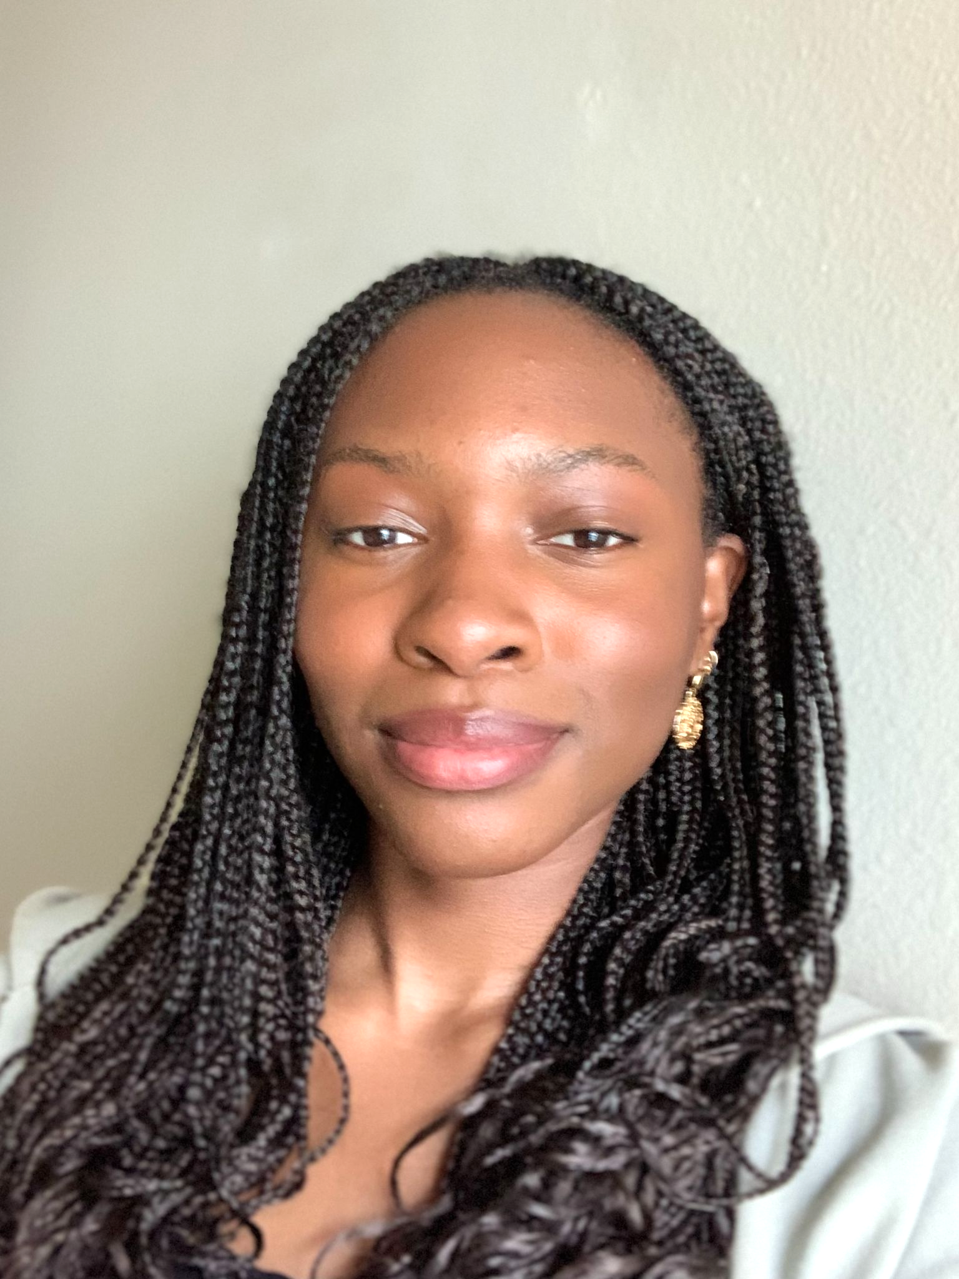
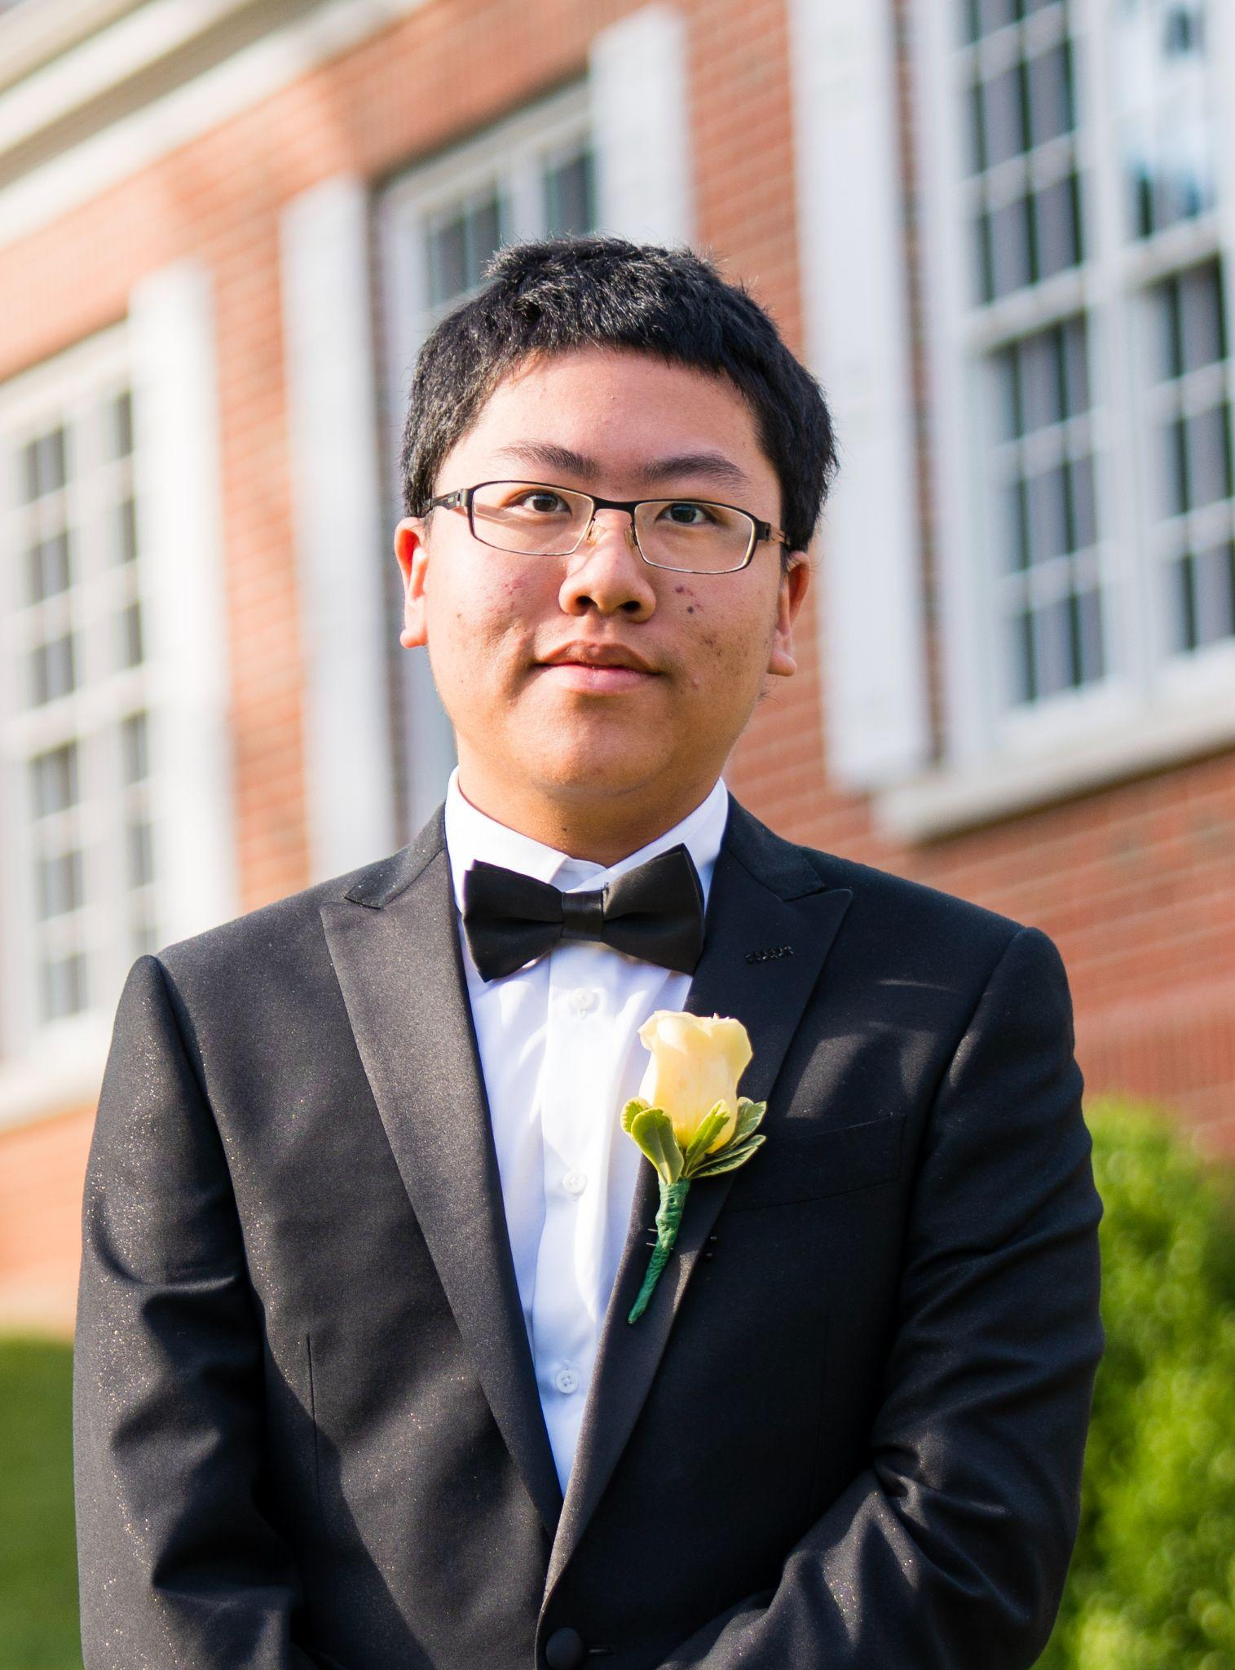
OUR TEAM
Mimi Olayeye
Brenda Cano
David Wei
Team Member
Team Member
Team member
Notes:
Mimi, Brenda, David

Slide 3
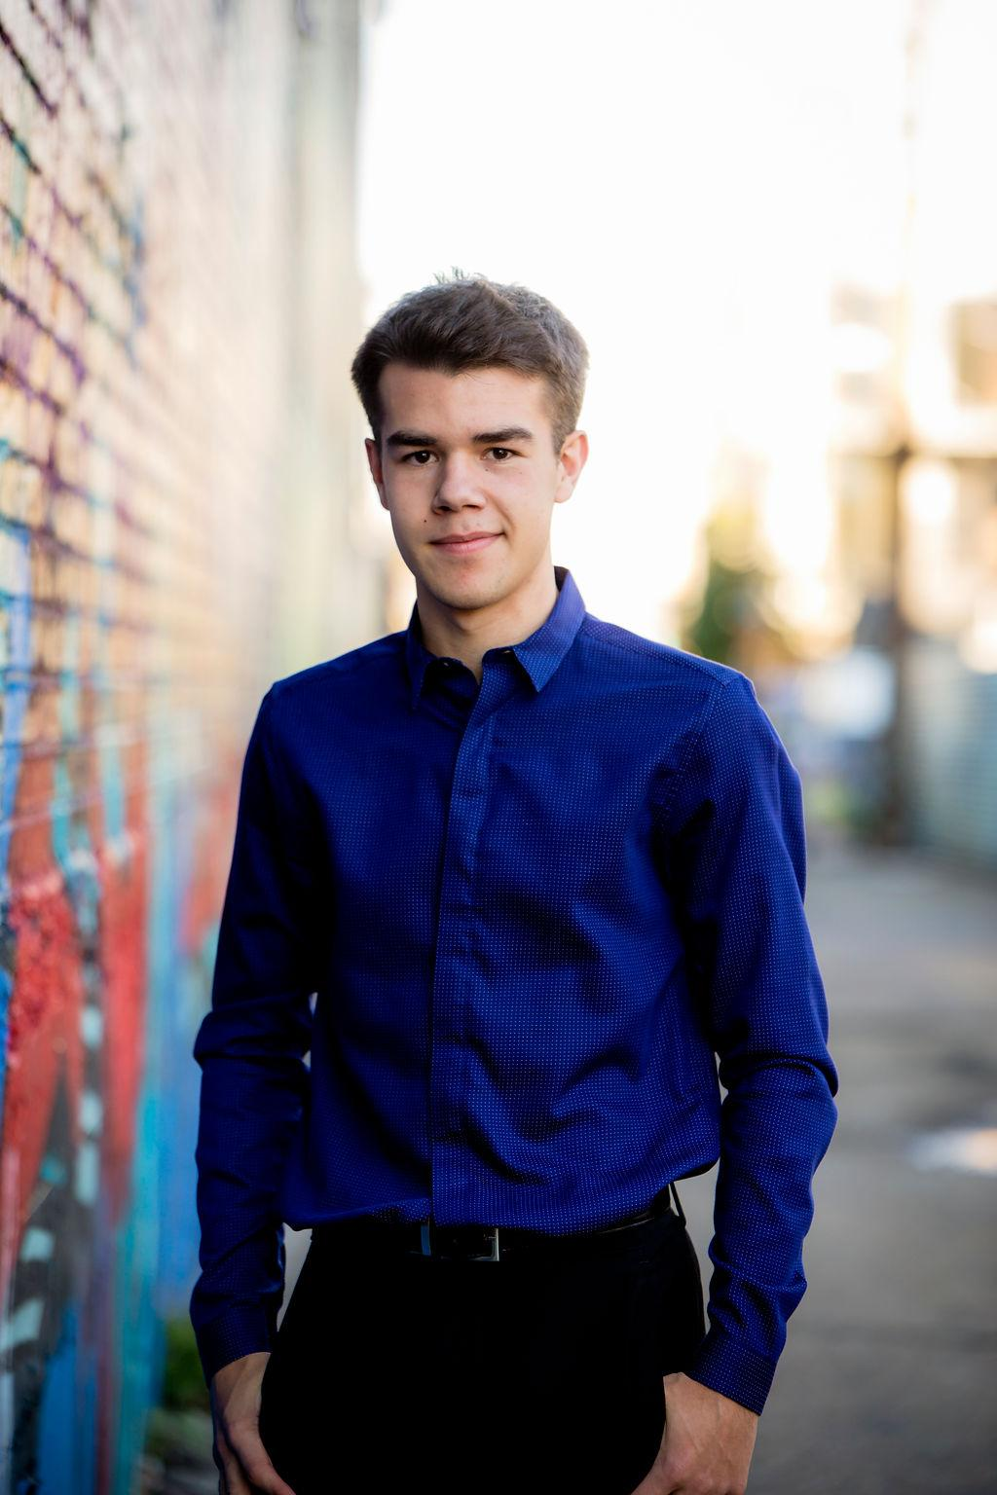


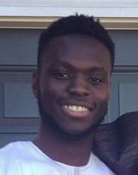

OUR TEAM
Ore Adenikinju
Miles Robertson
Rafael Piloto
Team member
Product Owner
Scrum Master
Notes:
Miles, Ore, Rafael

Slide 4
PROBLEM VS OUR SOLUTION (elevator pitch)
PROBLEM
SOLUTION
Returning from a pandemic, Emory University hasn’t quite figured out all the best systems yet. Coordinating a consistent student experience of classes and dining has yet to be achieved. Dining options are in flux and unclear.
An app that does all the thinking for you. Get notified when your favorite meals are served or when other friends are available to eat. Coordinate seating locations by viewing a heatmap of locations and see capacity statistics to beat rush hour and dine at the safest time.
Notes:
Miles

Slide 5
AGENDA
01
03
02
What did we accomplish?
What are our goals for the week?
Acknowledging feedback
Notes:
Miles

Slide 6
01
What did we accomplish?
Notes:
Rafael

Slide 7
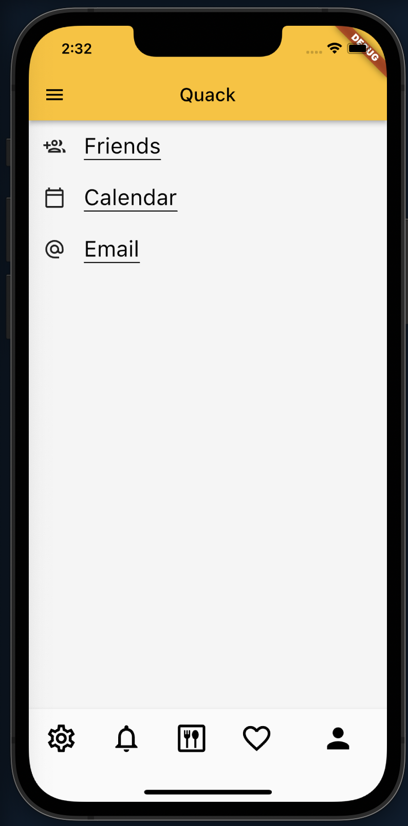
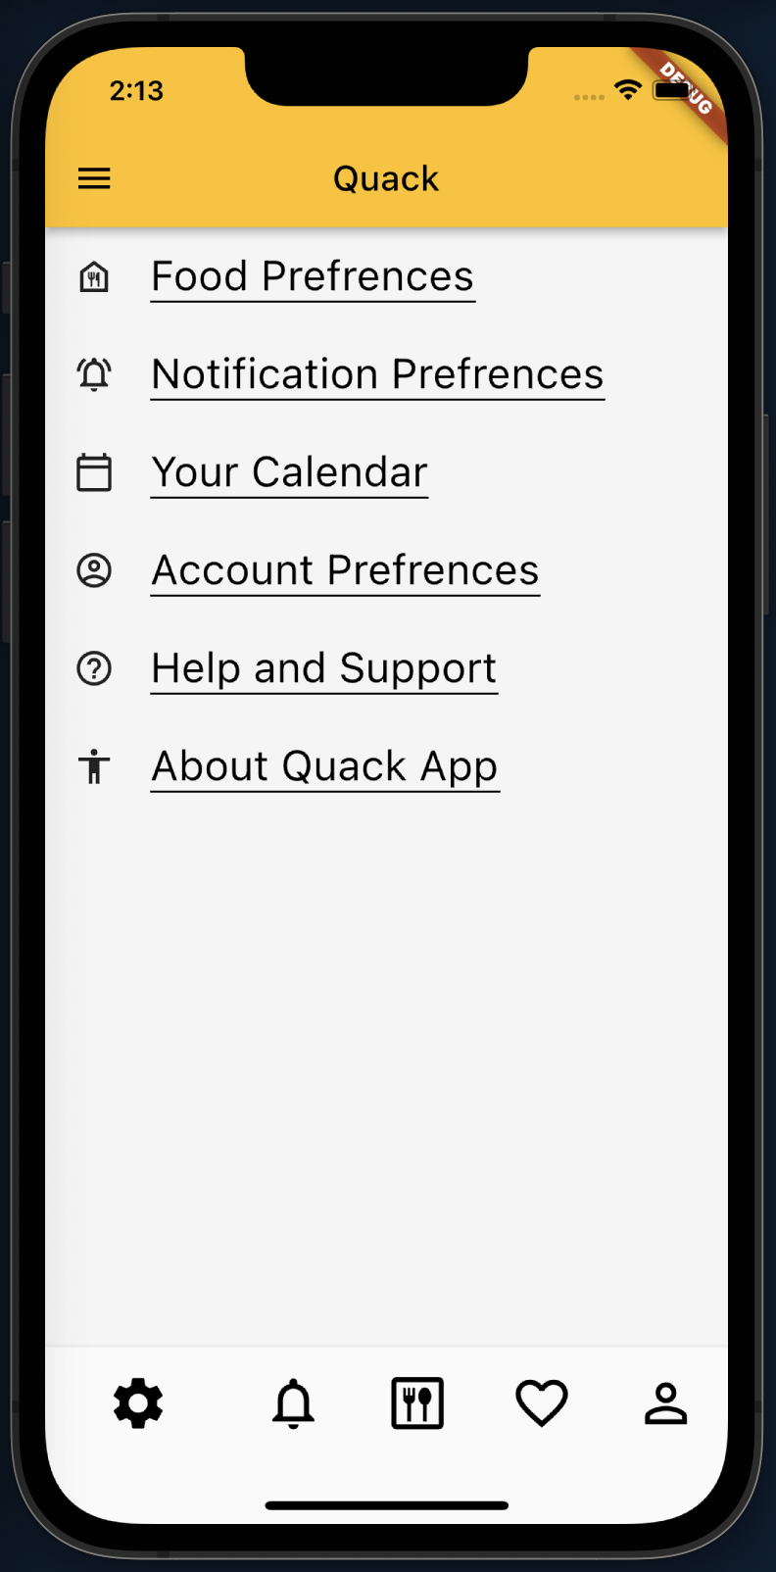
Preferences & Profile Screens
Notes:
rafael

Slide 8
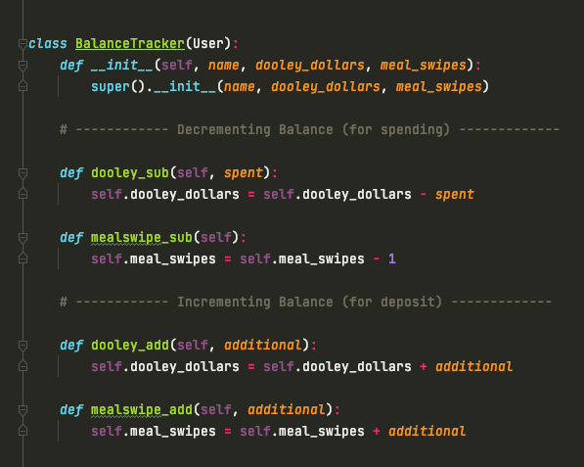
Meal Swipe / Dooley Tracker
App backend
Keeps track Dooley Dollars and meal swipes
Dependent on the user
Currently working on some edge cases and error handling
Notes:
Mimi

Slide 9

Favorite Screen
Notes:
David

Slide 10
Pair Programming
WHO
Mimi and Brenda
NEW IDEAS
Found different ways to test out the backend (i.e. Postman vs FastAPI web browser)
CODING
Discussed more edge cases to integrate within our respective tickets
Other pair programming will occur in future sprints
Notes:
Brenda

Slide 11
02
Acknowledging feedback
Notes:
Brenda

Slide 12
What is its purpose?
How do you get real time data?
Is it necessary/feasible?
Heat Map
Notes:
Brenda
Suggestions:
Dct heat map not feasible
Clarification on real time data from camera
Report feature in case menu is inconsisten with whats actually there
Is heat map necessary

Slide 13
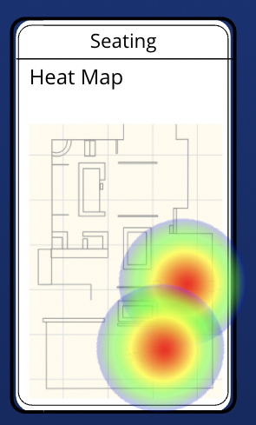
HEAT MAP
Purpose: visualizes the density inside the dining hall so you can know what areas are less populated
How: we can check out or purchase cameras and set them up in a section and detect the density with computer vision
It makes it easy to see what areas fill up first and it is a concept that has been done in real life
Notes:
Ore

Slide 14
03
What are our goals for the week?
Notes:
Miles

Slide 15
3 points
ahead of schedule!
Notes:
Miles

Slide 16
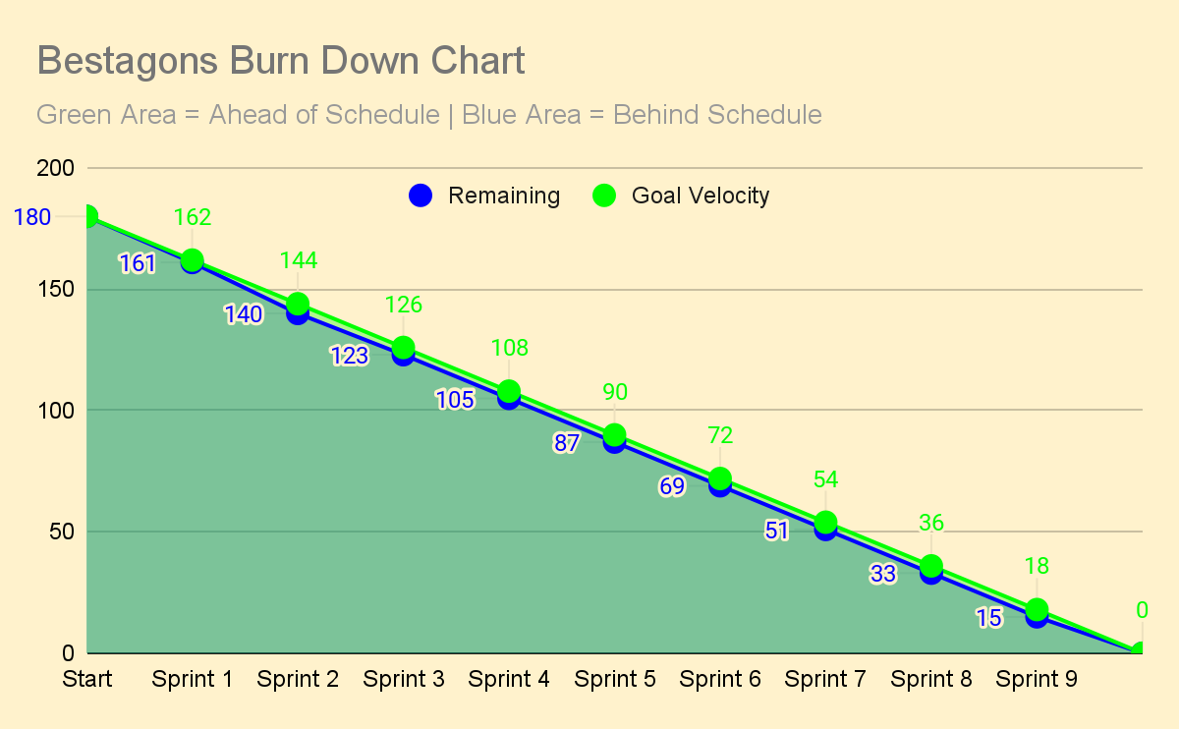
Notes:
Miles

Slide 17
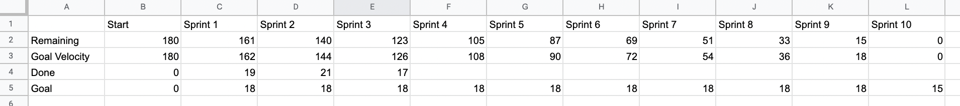
=($B2/10)*(10-VALUE(RIGHT(C1)))
=B2-IF(ISBLANK(C4),C5,C4)
Notes:
Miles: More demos & less wordy texts

Slide 18
Storytime: New Tickets Added
[2pts] Save Food Name
[2pts] Save Food Calories
Taco sides
smashed house-made black bean burger
650cal.
[2pts] Save Food Station
[2pts] Save Meal Time
Flatiron, Stem to Root, Fire, & Spice
Breakfast, Brunch, Lunch, Dinner
[2pts] Save Food Category
[2pts] Save Capacity
Vegan, GF, etc.
Seated + Takeout
Thus Sprint 5 will be geared toward DCT Backend Development
Notes:
Miles

Slide 19
THANKS
Please remember to share your feedback :)
Notes:
Miles

